Slide 1
FHIR for Software Developers
HL7 Working Group Meeting
Atlanta, GA
Richard J Ettema

Slide 2

Instructor
Richard J Ettema
36+ years IT industry experience
16+ years leading HIT development/implementation efforts
6+ years contributing to the HL7® FHIR® specification
Focus on Testing
Sr. Architect / Lead Developer of the Touchstone FHIR® Testing Platform
Author of the AEGIS WildFHIR public test server and client

Slide 3
This Presentation
Is licensed for use under the Creative Commons license, specifically:
Creative Commons Attribution 3.0 Unported License
(Do with it as you wish, so long as you give credit)

Slide 4
Acknowledgements / Credits
Grahame Grieve
Lloyd McKenzie
Ewout Kramer
David Hay
Josh Mandel
Jean Duteau
Rik Smithes
et al

Slide 5

Introductions and Level Setting
You should be familiar with the basics of FHIR
From Introduction to FHIR or equivalent presentation or experience
This presentation will drill a little deeper into FHIR:
Resources
Profiling
Documents
Messaging
XML and JSON Syntax
Coding examples (Java, C#)
etc.
There’s a lot of information…

Slide 6
Contents / Agenda
Background and Helpful Resources
FHIR Resources – a little review and a deeper dive
Interoperability Paradigms
REST, Documents, Messaging and Services/Operations
Searching – a fundamental part of FHIR
FHIR Profiling and Validation
Implementing FHIR
Java and C# Code Examples, Building the Spec, Java Reference Source Code
Final Thoughts

Slide 7

Background and Helpful Resources

Slide 8
FHIR Release and Publication Status
Current version is R4 (released December 2018)
Previous versions were “STU” – Standard for Trial Use
R4 is the first version with (some) Normative content
R5 will build on R4 by:
Moving more content to formal Normative status
Further improving the support for publishing implementation guides
Adding additional content in newly developing domains
Improving support for applications using multiple FHIR releases seamlessly as well as multi-language support and federated servers
Adding new facilities for migrating data to and from v2 messages and CDA documents
Targeted for release in mid/late 2020

Slide 9
FHIR Timeline – Past, Present and Future
First Normative Content
First Draft
1st
DSTU
2nd
DSTU
3rd
STU
R4
R5
2011
2012
2013
2014
2015
2016
2017
2018
2019
2020

Slide 10
Development Resources
Public Test Servers
http://wiki.hl7.org/index.php?title=Publicly_Available_FHIR_Servers_for_testing
Varying capabilities and FHIR version support; e.g.
HAPI (Java)
Vonk (C# .NET)
Many more…
Invaluable to experiment
Typical features:
Manual interaction
Validation
Core and extended operations
Useful Tools
http://hl7.org/fhir/downloads.html
Modern web browser
REST client
XML/JSON editor
Source Code
http://hl7.org/fhir/downloads.html
RI: Java / C# .NET / JavaScript / others
Examples, Schemas
Validation

Slide 11
Testing Platforms
Crucible (MITRE) https://www.projectcrucible.org
Supports FHIR DSTU2, STU3 and R4
FHIR Server Testing
Touchstone (AEGIS.net, Inc.) http://touchstone.com
Supports FHIR DSTU2, STU3, R4 and all intermediate or snapshot (Connectathon) versions
FHIR Client and Server Testing

Slide 12
clinFHIR http://clinfhir.com
Publicly available FHIR Client
Originally designed to support the Clinicians on FHIR events
Provides a suite of educational tools:
View resource instances
Build resources
View Profiles
Build simple profiles
Build simple ValueSets

Slide 13
The FHIR Community
HL7 FHIR Foundation – http://www.fhir.org
FHIR Chat (Zulip) – https://chat.fhir.org
FHIR Community Forum – http://community.fhir.org
FHIR on Stack Overflow – http://stackoverflow.com/questions/tagged/hl7-fhir
FHIR Listsrv – fhir@lists.hl7.org
FHIR Wiki – http://wiki.hl7.org/index.php?title=FHIR
Moving to HL7 Confluence - https://confluence.hl7.org/display/FHIR/Home
FHIR gForge Tracker – http://wiki.hl7.org/index.php?title=FHIR_gForge_Tracker
Moving to HL7 JIRA - https://jira.hl7.org/secure/Dashboard.jspa

Slide 14
FHIR – Elevator Pitch…
FHIR is:
About clinical information exchange
“Resources” to represent clinical ‘things’
A well-defined API supporting multiple paradigms
An incredible – international – community
Spreading like <insert your favorite pun here>
All the above!

Slide 15
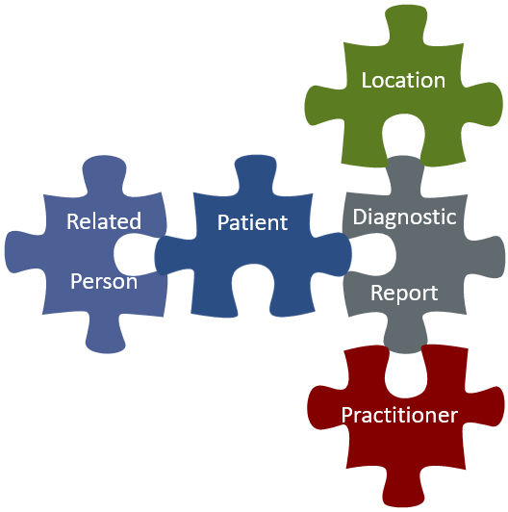
FHIR Resources
a little review and some more detail …

Slide 16

FHIR Resources – Review
are small logically discrete units of exchange
have defined behaviour and meaning
have a known identity / location
is the smallest unit of transaction
is “of interest” to healthcare
V2 comparison: Sort of like Segments
V3 comparison: Sort of like CMETs (Common Message Element Types)

Slide 17
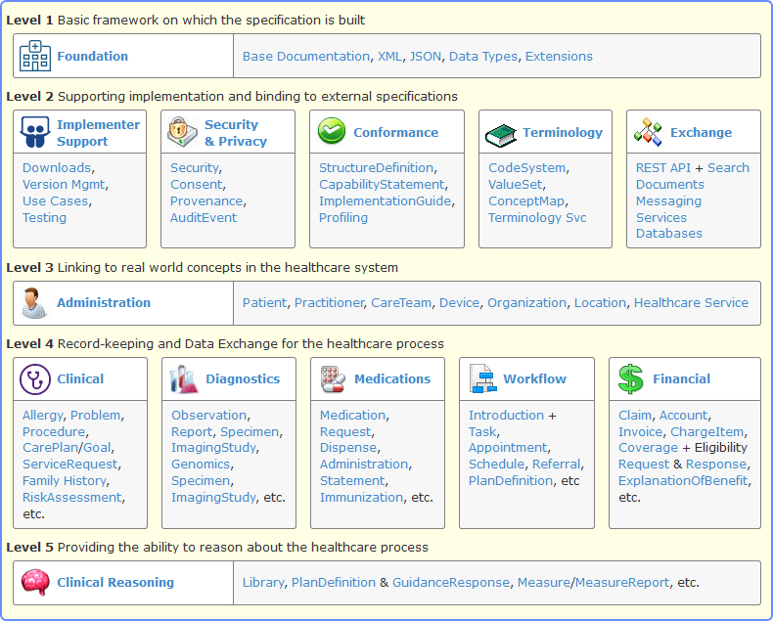
FHIR Resources – Modules http://hl7.org/fhir/index.html

Slide 18
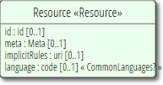
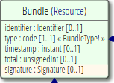
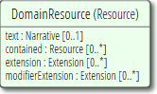
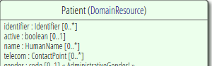
FHIR Resources – Resource Hierarchy
All the FHIR Resource types are defined using an inheritance hierarchy
The base type is “Resource” and it defines:
The logical ‘id’ of the resource instance
Metadata about the resource
A set of implicit rules about the resource content
The language of the resource content
Binary, Bundle, Parameters extend the “Resource” type
The next type is “DomainResource” and it defines:
The human-readable narrative text (XHTML)
Contained resources
Additional extensions and modifier extensions
All other listed Resource types extend from “DomainResource”

Slide 19
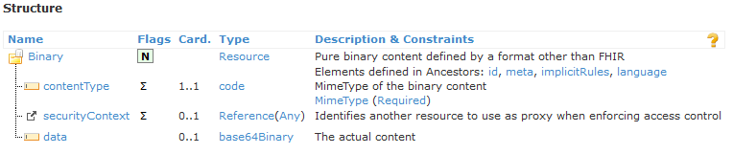

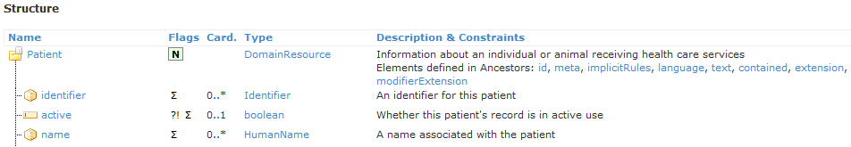
FHIR Resources – Resource Hierarchy

Slide 20
FHIR Resources – Where are these elements defined?
<Patient xmlns="http://hl7.org/fhir">
<id value="example"/>
<meta>
<lastUpdated value="2017-01-14T09:14:33Z"/>
</meta>
<text>
<status value="generated"/>
<div xmlns="http://www.w3.org/1999/xhtml">
<p>Henry Levin the 7th</p>
</div>
</text>
<extension url="http://hl7.org/fhir/StructureDefinition/us-core-birthsex">
<valueCode value="M"/>
</extension>
<identifier>
<use value="usual"/>
<system value="urn:oid:1.2.36.146.595.217.0.1"/>
<value value="12345"/>
</identifier>
<active value="true"/>
<name>
<use value="official"/>
<family value="Levin"/>
<given value="Henry"/>
<suffix value="the 7th"/>
</name>
<gender value="male"/>
<birthDate value="1974-12-25"/>
<managingOrganization>
<reference value="Organization/example"/>
</managingOrganization>
</Patient>
Resource
Identity & Metadata
DomainResource
Human Readable Summary
DomainResource
Extension with reference to its definition
Standard Data Content:
MRN
Name
Gender
Date of Birth
Provider

Slide 21
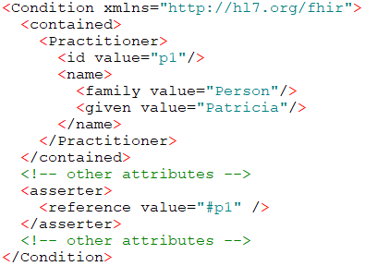
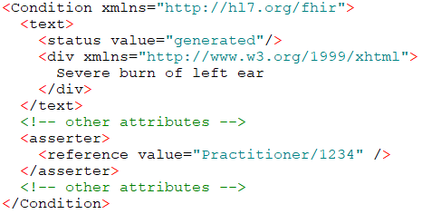
FHIR Resources – Composition vs. Reference
Contained Resources provide Composition
Contained Resources have no meaning outside the containing Resource; i.e. no independent identity
No separate access path except through the containing resource
Referenced Resources
References are between independent Resources
Each individual Resource is safe to retrieve on its own

Slide 22
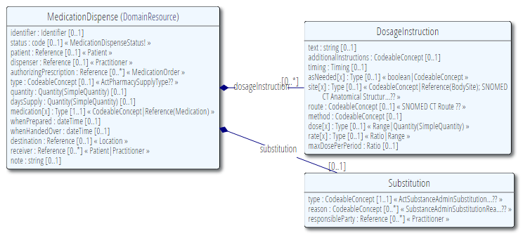
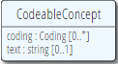
FHIR Resources – Basic Structure
Resource Root
Resource Component
Simple & Complex elements (may be repeating)

Slide 23
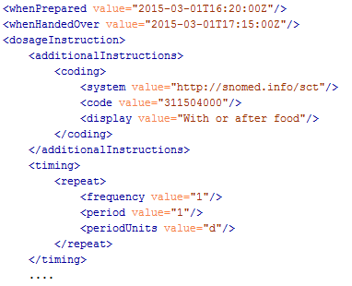
FHIR Resources – Basic Structure

Slide 24
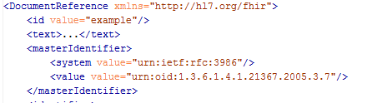
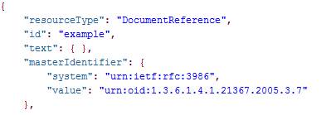
FHIR Resources – Syntax (review) – XML and JSON

Slide 25
FHIR Resources – Recording a Consultation What FHIR Resources?
12-year-old-boy
First consultation with Dr. Smith
Complaining of pain in the right ear for 3 days with an elevated temperature. On examination, temperature 38°C and an inflamed right eardrum with no perforation. Diagnosis Otitis Media, and prescribed Amoxicillin 250mg 3 times per day for 7 days.
Follow up consultation with Dr. Smith
2 days later returned with an itchy skin rash and breathing difficulties. On examination, urticarial rash on both arms. No evidence meningitis. Diagnosis of penicillin allergy. Antibiotics changed to Erythromycin 250mg 4 times per day for 10 days.
Practitioner
Patient
Encounter
Condition
Observation
Medication
Allergy Intolerance

Slide 26
Pain right ear 3 days
Asserter
Patient
Encounter
Elevated temperature
Performer
Temperature 38°C
Performer
Practitioner
Inflamed right drum
Performer
Otitis media
Asserter
Amoxicillin 250mg
Prescriber
Itchy skin rash
Asserter
Encounter
No breathing difficulties
Asserter
Urticarial Rash
Performer
Condition
Observation
Medication
AllergyIntolerance
Penicillin Allergy
Performer
Erythromycin 250mg
Performer

Slide 27
FHIR Resources – Metadata http://hl7.org/fhir/resource.html#Meta
Beyond ‘id’ – version and last updated date
Source system – minimal provenance type to track the original source of the data
Tags – to indicate purpose(s) of use:
<profile> → Compliance to one or more profiles
<security> → Security – e.g. sensitivity of the resource data
<tag> → User defined – e.g. test data
May be transported or conveyed via:
REST – as an HTTP header
In a Bundle (document, message, transaction)
In the metadata element of the resource (as shown)
<id value="4705149-patient"/> <meta> <versionId value="4"/> <lastUpdated value="2019-04-12"/>
<source value=… />
<profile value=… />
<security value=…/>
<tag value= …/> </meta>

Slide 28
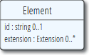
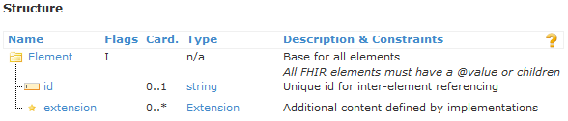
FHIR Resources – Element http://hl7.org/fhir/element.html
The base definition for all elements contained within a resource
All element types extend this base type, whether defined as a Data Type (including primitives) or as part of a resource structure
Base content includes:

Slide 29
FHIR Resources – Element Hierarchy http://hl7.org/fhir/patient.html#resource
Element
(+id, +Extensions)
Primitive Data Types
(no children)
Complex Data Types
(can have children)
Backbone Element
(+modifierExtension)
(can have children)

Slide 30
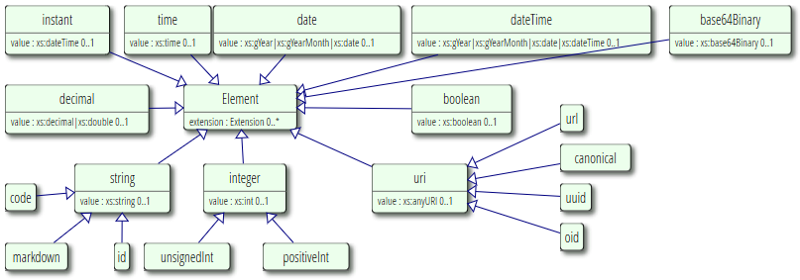
FHIR Resources – Primitive Data Types http://hl7.org/fhir/datatypes.html#primitive
Primitive types only have a value, no sub-elements
May have extensions because they extend Element

Slide 31
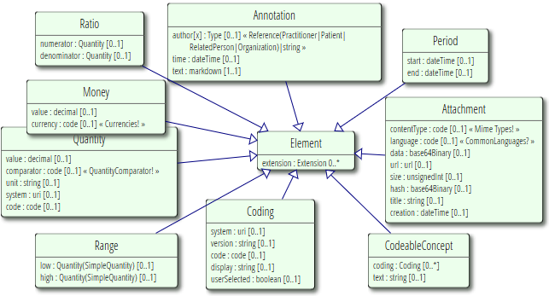
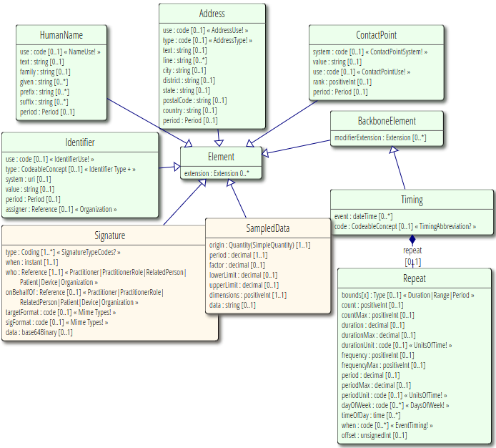
FHIR Resources – Complex Data Types http://hl7.org/fhir/datatypes.html#complex
Complex types only have sub-elements, do not have a value
May have extensions because they extend Element

Slide 32
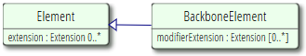
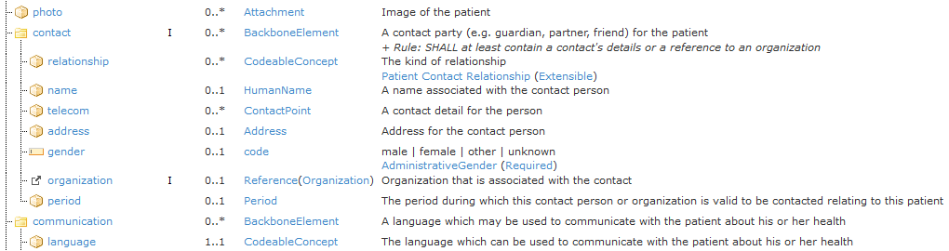
FHIR Resources – Backbone Element http://hl7.org/fhir/backboneelement.html
Example – Patient.contact
Base definition for complex types defined as part of a resource; only have sub-elements, do not have a value
Adds modifier extensions

Slide 33
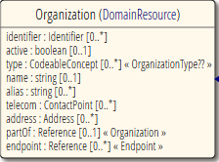
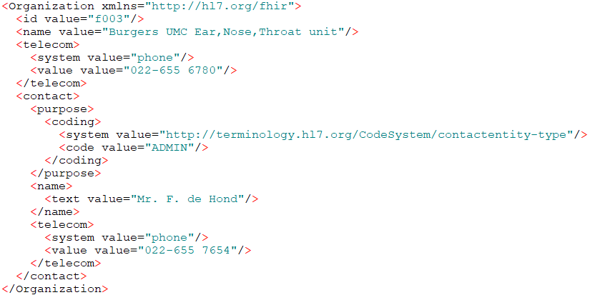
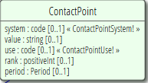
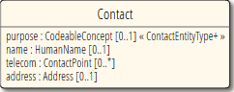
FHIR Resources – Content to Definition
Resource
Complex Data Type
Backbone Element

Slide 34
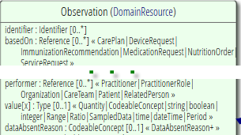
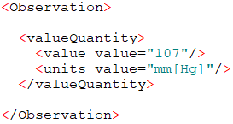
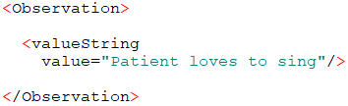
FHIR Resources – “Choice” of Data Types http://hl7.org/fhir/formats.html#choice
A few elements have a choice of more than one data type
The element name is defined as “nnn[x]” where
The “nnn” part of the name is constant
The “[x]” is replaced with the title-cased type actually used
Example, Observation.value[x]

Slide 35
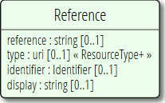
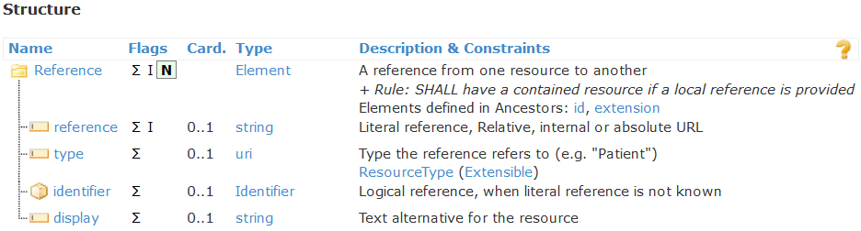
FHIR Resources – References http://hl7.org/fhir/references.html#Reference
In resources, a Reference always points to another resource
Must contain at least one of reference, identifier and display (or have an extension)

Slide 36
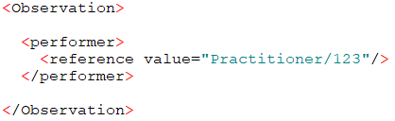
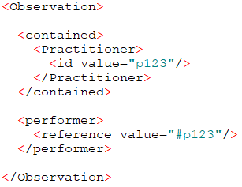
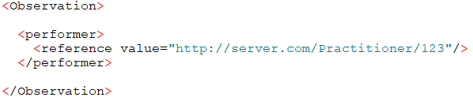
FHIR Resources – Literal References http://hl7.org/fhir/references.html#literal
reference is the key element and can be:
A relative URL (to the server base URL)
An internal fragment (Contained resource)
An absolute URL
Examples

Slide 37
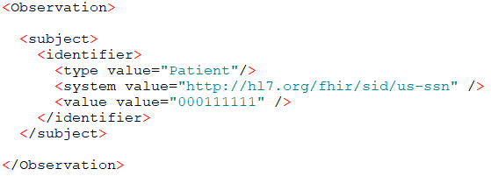
FHIR Resources – Logical References http://hl7.org/fhir/references.html#logical
identifier is the key element and is used when:
There is not server exposing the resource
The server exposing the resource is not available
The application is not in a RESTful environment
Example, logical reference to a Patient by SSN

Slide 38
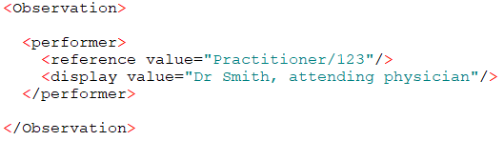
FHIR Resources – Reference Description (Display) http://hl7.org/fhir/references.html#display
display is the key element and may be used:
With either/both reference and identifier
Neither reference or identifier
To provide a brief description of the target resource
In general, does not duplicate resource specific data
Example, a short description of the referenced Practitioner

Slide 39
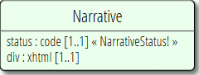
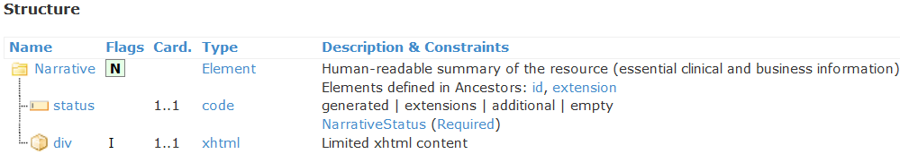
FHIR Resources – Narrative http://hl7.org/fhir/narrative.html#Narrative
Narrative.status
generated – contents entirely generated from core elements
extensions – ‘generated’ + contents of extensions
additional – may contain information not found in the structured data
empty – contents represent “No human-readable text provided”
Narrative.div
An XHTML fragment that SHALL contain only the basic HTML formatting elements
No active or executable content

Slide 40
FHIR Resources – Narrative http://hl7.org/fhir/narrative.html#Narrative
<Patient xmlns="http://hl7.org/fhir">
<id value="example"/>
<meta>
<lastUpdated value="2017-01-14T09:14:33Z"/>
</meta>
<text>
<status value="generated"/>
<div xmlns="http://www.w3.org/1999/xhtml">
<p>Henry Levin the 7th</p>
</div>
</text>
<extension url="http://hl7.org/fhir/StructureDefinition/us-core-birthsex">
<valueCode value="M"/>
</extension>
<identifier>
<use value="usual"/>
<system value="urn:oid:1.2.36.146.595.217.0.1"/>
<value value="12345"/>
</identifier>
<active value="true"/>
<name>
<use value="official"/>
<family value="Levin"/>
<given value="Henry"/>
<suffix value="the 7th"/>
</name>
<gender value="male"/>
<birthDate value="1974-12-25"/>
<managingOrganization>
<reference value="Organization/example"/>
</managingOrganization>
</Patient>
Identity & Metadata
Human Readable Summary
Extension with reference to its definition
Standard Data Content:
MRN
Name
Gender
Date of Birth
Provider

Slide 41
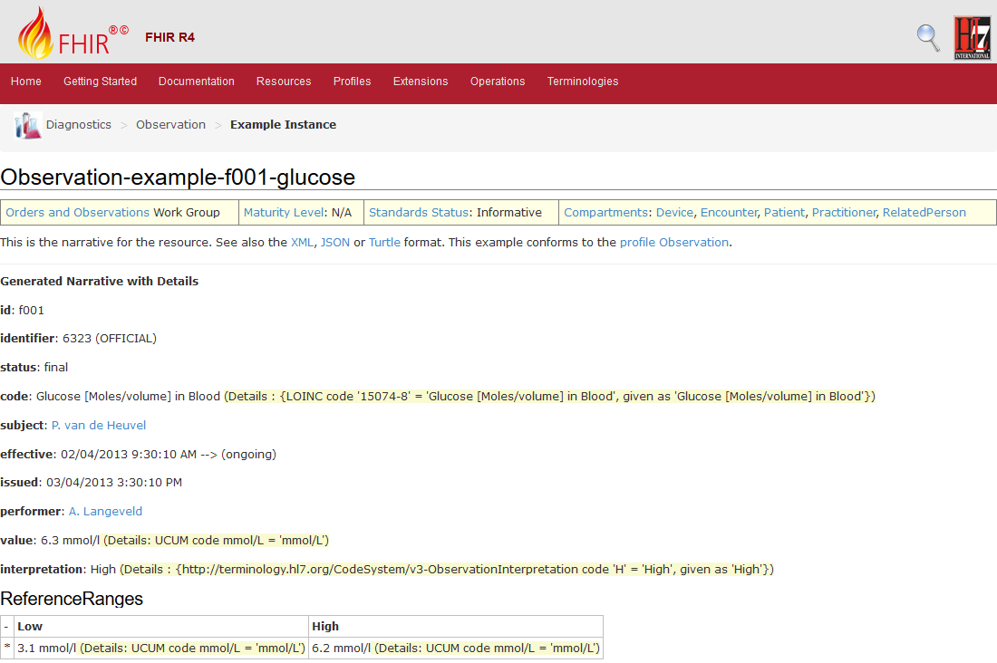
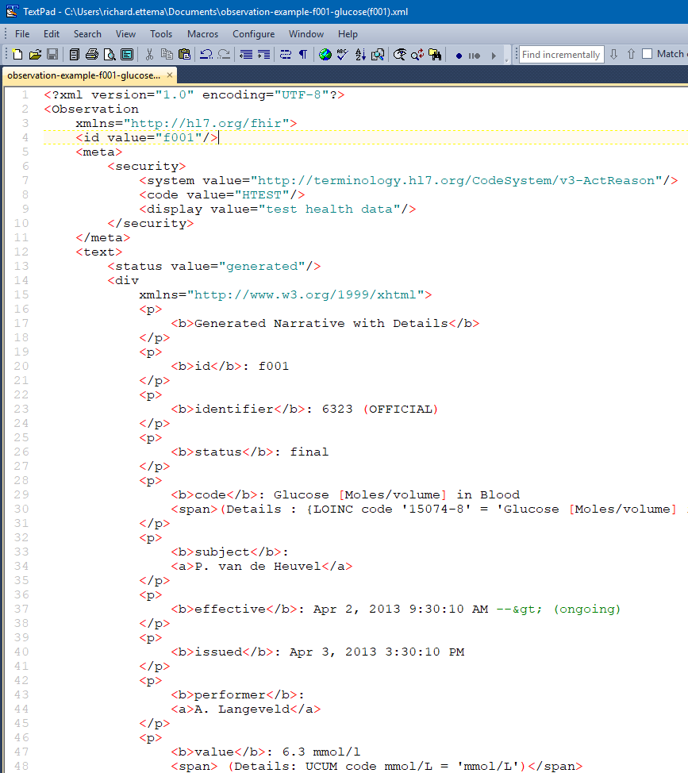
FHIR Resources – Narrative Example (from the spec) http://hl7.org/fhir/observation-example-f001-glucose.html

Slide 42
FHIR Resources – Types of Coded Data (review)
‘code’ data type
e.g. – Patient gender can be “male” or “female”
‘CodeableConcept’ data type
e.g. – Observation code for a Blood Glucose measurement:
LOINC – “2339-0” (Glucose [Mass/volume] in Blood)
Displayed as “Glucose, Blood”
‘Quantity’ data type
Units of measure for the Blood Glucose measurement
80 UCUM units = mg/dL

Slide 43
FHIR Resources – Examples of Coded Data (review) http://hl7.org/fhir/datatypes-examples.html#codeableconcept
‘code’ – Patient gender
<gender value=“male”/>
‘CodeableConcept’ – Observation code
<code>
<coding>
<system value=“http://snomed.info/sct”/>
<code value=“39579001”/>
<display value=“Anaphylactic reaction”/>
</coding>
<text value=“Anaphylaxis”/>
</code>
“gender” : “male”
“code” : {
“coding” : [{
“system” : “http://snomed.info/sct”,
“code” : “39579001”,
“display” : “Anaphylactic reaction”
}],
“text” : “Anaphylaxis”
}

Slide 44
FHIR Resources – Binding Strength (review)
Defines how closely the coded values in the ValueSet should be followed
Values
Required (must come from this ValueSet - !)
Extensible (may use alternate if needed - +)
Preferred (don’t have to, but should - ?)
Example (ValueSet isn’t specified - ??)
Can be modified within a Profile
Stronger (more restrictive), not weaker

Slide 45
FHIR Resources – Bindings (review+)
Code System:
Defines a set of concepts with a coherent meaning Code Display
Definition
Value Set:
A selection of a set of codes for use in a particular context
Element Definition:
Type and ValueSet reference
Binds
Selects
Conforms
Refers to
Element: code/ Coding/ CodeableConcept

Slide 46
FHIR Resources – Bundles
Bundle is a FHIR Resource for containing other Resources
Used when more than one Resource may be needed
Query / Search results (later)
Documents (later)
Messages (later)
Batch / Transaction
A technical grouping rather than a logical one
No inherent business meaning in the grouping, unlike the List Resource

Slide 47
FHIR Supports 4 Interoperability Paradigms
Documents
Messages
Services
REST

Slide 48
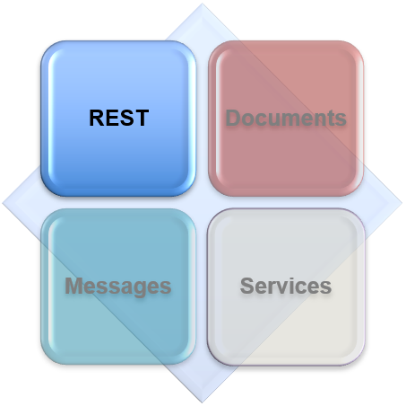
Interoperability paradigms
REST

Slide 49
REST Paradigm http://hl7.org/fhir/http.html
“REpresentational State Transfer” protocol
Represent your data as “resources”
Make “Resource” URI addressable
Use HTTP methods to perform CRUD operations
FHIR extends the HTTP methods for additional base operations
Resources may be exchanged using different formatted representations
XML, JSON, etc.

Slide 50
REST Paradigm – Supports distributed environment
FHIR server @ pat.registry.org
FHIR server @ lab.hospitalA.org
Patient/223
DiagnosticReport/4445
Observation/3ff27
Patient
Observation
subject
DiagnosticReport
result
managing
performer
FHIR server @ hospitalA.org
Organization/1
Practitioner/87
Organization
Practitioner

Slide 51

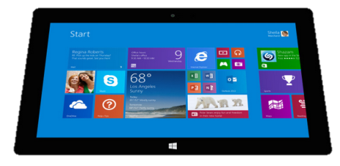
REST Paradigm – Repository Model
Hospital System
Lab System
Create
Update
Create
Update
Create
Update
Subscribe/
Notify
Query
Query
FHIR server
Diagnostic
Report
Organization
Patient
Observation

Slide 52
REST Paradigm – Metadata mapping to HTTP http://hl7.org/fhir/resource.html#Meta
Metadata
Resource data
Resource id
Resource version
Last update date
HTTP
Body or payload
URL path
URL path or ETag header
Last-Modified header

Slide 53
REST Paradigm – GET / Read a Resource (review)
resource type
https://server.org/fhir/Patient/1234
Note: This URL resolves to the current version of a resource. It’s also specific to a server.
endpoint
id

Slide 54
REST Paradigm – GET Details
HTTP Verb + Path
REQUEST
GET https://server.org/fhir/Patient/1234 HTTP/1.1
Accept: application/fhir+xml;charset=utf-8
RESPONSE
HTTP/1.1 200 OK
Content-Type: application/fhir+xml;charset=utf-8
Content-Length: 932
Last-Modified: Thu, 25 April 2019 13:45:32 GMT
<?xml version="1.0" encoding="UTF-8"?>
<Patient xmlns="http://hl7.org/fhir"><id value="example"/><meta><security><system value="http://terminology.hl7.org/CodeSystem/v3-ActReason"/><code value="HTEST"/><display value="test health data"/></security></meta><identifier><system value="urn:oid:1.2.36.146.595.217.0.1"/><value value="12345"/></identifier><active value="true"/><name><use value="official"/><family value="Chalmers"/><given value="Peter"/><given value="James"/></name><telecom><system value="phone"/><value value="(03) 5555 6473"/><use value="work"/><rank value="1"/></telecom><gender value="male"/><birthDate value="1974-12-25"/><deceasedBoolean value="false"/><address><use value="home"/><line value="534 Erewhon St"/><city value="PleasantVille"/><district value="Rainbow"/><state value="Vic"/><postalCode value="3999"/></address><managingOrganization><reference value="Organization/1"/></managingOrganization></Patient>
UTF-8 Encoding

Slide 55
REST Paradigm – GET a Specific Version of a Resource
resource type
GET https://server.org/fhir/Patient/1234/_history/1
endpoint
id
version id

Slide 56
REST Paradigm – POST / Create a Resource
resource type
POST https://server.org/fhir/Patient
endpoint
Format of the body defined and sent in the Content-Type header
Success response is a 201 (Created)
The Location header contains the newly assigned resource id and version id
The ETag header may also contain the newly assigned version id

Slide 57
REST Paradigm – POST Details
HTTP Verb + Path
REQUEST
POST https://server.org/fhir/Patient HTTP/1.1
Accept: application/fhir+xml;charset=utf-8
Content-Type: application/fhir+xml;charset=utf-8
Body (Patient Resource)
RESPONSE
HTTP/1.1 201 Created
Content-Type: application/fhir+xml;charset=utf-8
Content-Length: 932
ETag: W/”1”
Location: https://server.org/fhir/Patient/1234/_history/1
Last-Modified: Thu, 25 April 2019 13:45:32 GMT
Body (Patient or OperationOutcome Resource)
Assigned version id

Slide 58
REST Paradigm – PUT / Update a Resource
resource type
PUT https://server.org/fhir/Patient/1234
endpoint
id
PUT on the resource’s identifying URL
Format of the body defined and sent in the Content-Type header
Success response is a 200 (OK)
The Location header contains the newly assigned version id
The ETag header may also contain the newly assigned version id

Slide 59
REST Paradigm – PUT Details
HTTP Verb + Path
REQUEST
PUT https://server.org/fhir/Patient/1234 HTTP/1.1
Accept: application/fhir+xml;charset=utf-8
Content-Type: application/fhir+xml;charset=utf-8
Body (Patient Resource)
RESPONSE
HTTP/1.1 200 OK
Content-Type: application/fhir+xml;charset=utf-8
Content-Length: 932
ETag: W/”2”
Location: https://server.org/fhir/Patient/1234/_history/2
Last-Modified: Thu, 25 April 2019 13:45:32 GMT
Body (Patient or OperationOutcome Resource)
Next version id

Slide 60
REST Paradigm – Version Aware Updates http://hl7.org/fhir/http.html#concurrency
If-Match header → uses ETag value from most recent create, read or update
REQUEST
PUT https://server.org/fhir/Patient/1234 HTTP/1.1
Accept: application/fhir+json;charset=utf-8
Content-Type: application/fhir+json;charset=utf-8
If-Match: W/”2”
Body (Patient Resource)
RESPONSE
If the given version id matches, perform update
If NOT, return an HTTP/1.1 412 Precondition Failed

Slide 61
REST Paradigm – Update as Create (upsert) http://hl7.org/fhir/http.html#upsert
Client resource id
Server MAY allow clients to PUT a resource that does not yet exist
Allows client to define the resource id on the server
REQUEST
PUT https://server.org/fhir/Patient/client1234 HTTP/1.1
Accept: application/fhir+json;charset=utf-8
Content-Type: application/fhir+json;charset=utf-8
Body (Patient Resource)
RESPONSE
If resource does not exist and server supports, create
If NOT supported, return an HTTP/1.1 405 Method Not allowed

Slide 62
REST Paradigm – Conditional Create Operation (Trial Use) http://hl7.org/fhir/http.html#ccreate
Search criteria is defined in ‘If-None-Exist’ header
POST https://server.org/fhir/Patient HTTP/1.1
If-None-Exist: family=Smith&given=John&birthdate=1955-01-12
Accept: application/fhir+xml;charset=utf-8
Content-Type: application/fhir+xml;charset=utf-8
Body (Patient Resource)
Before processing the create, perform a search using the criteria
No Match → Process create
One Match → Ignore create and return HTTP/1.1 200 OK
Multiple Matches → Error! Return HTTP/1.1 412 Precondition Failed

Slide 63
REST Paradigm – Conditional Update Operation (Trial Use) http://hl7.org/fhir/http.html#cond-update
Search criteria is defined in update URL path (same as search operation)
PUT https://server.org/fhir/Patient/1234?family=Smith&given=John&birthdate=1955-01-12 HTTP/1.1
Accept: application/fhir+xml;charset=utf-8
Content-Type: application/fhir+xml;charset=utf-8
Body (Patient Resource)
Before processing the update, perform a search using the criteria
No Match and no id in URL → Process as a create
No Match and id is in URL → Process as an update, or update as create
One Match → Process update
Multiple Matches → Error! Return HTTP/1.1 412 Precondition Failed

Slide 64

REST Paradigm – Conditional Delete Operation (Trial Use) http://hl7.org/fhir/http.html#3.1.0.7.1
Search criteria is defined in delete URL path (same as search operation)
DELETE https://server.org/fhir/Patient/1234?family=Smith&given=John&birthdate=1955-01-12 HTTP/1.1
Accept: application/fhir+xml;charset=utf-8
Before processing the delete, perform a search using the criteria
No Match or One Match → Process delete
Multiple Matches (supported) → Delete ALL matching resources
Multiple Matches (not supported) → Error! Return HTTP/1.1 412 Precondition Failed
CAUTION

Slide 65
REST Paradigm – Delete (is it really gone?)
Delete - http://hl7.org/fhir/http.html#delete
Reading a resource that does not exist returns an HTTP/1.1 404 Not Found
Reading a deleted resource returns an HTTP/1.1 410 Gone
Deleted resources are not returned in a search response
The history operation will return an empty entry for any deleted resource version
Deleted resources may be “undeleted” using an update operation
Deleting a resource simply makes a new version of the resource “marked” as deleted

Slide 66
REST Paradigm – Version History and Revival (review) http://hl7.org/fhir/http.html#history
1234, v13 – 2019-04-15
/server.org/fhir/Patient/1234/_history/13
1234, v14 – 2019-04-16
/server.org/fhir/Patient/1234/_history/14
1234, v15 – 2019-04-17
/server.org/fhir/Patient/1234/_history/15
1234, v16 – 2019-04-18
/server.org/fhir/Patient/1234/_history/16 (gets deleted)
1234, v17 – 2019-04-19
/server.org/fhir/Patient/1234/_history/17
PUT /server.org/fhir/Patient/1234 (it’s alive)

Slide 67
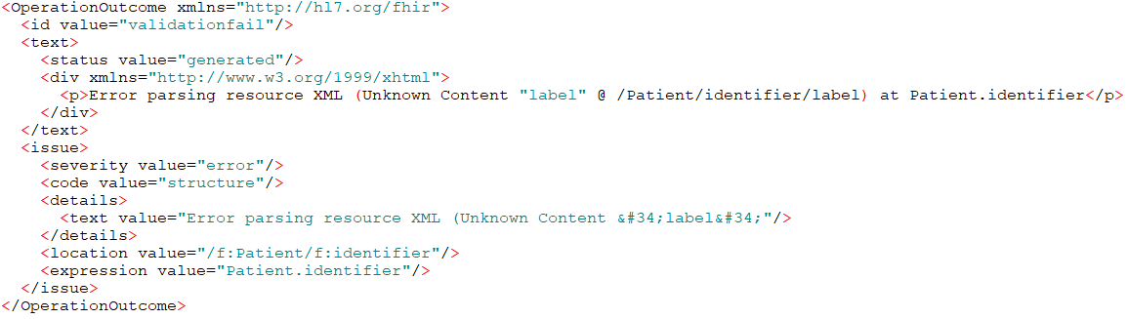
REST Paradigm – OperationOutcome
When something goes wrong … return the OperationOutcome resource

Slide 68
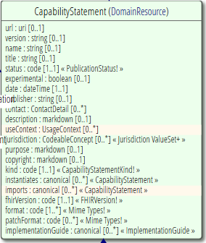
REST Paradigm – CapabilityStatement http://hl7.org/fhir/capabilitystatement.html
Which FHIR version?
What Resources?
What search parameters?
What formats?
Type of server/client
Who can I contact?
Software name
…

Slide 69
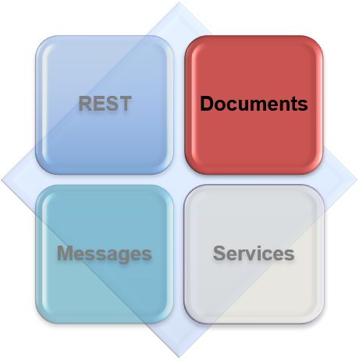
Interoperability paradigms
Documents

Slide 70
Documents Paradigm http://hl7.org/fhir/documents.html
Similar in structure to CDA documents
A collection of resources bound together
Root is a “Composition” Resource Type
Just like the CDA header section
Uses the Bundle Resource Type
Special operation for handling documents:
$document – Generate a document Bundle from a Composition
Defines a single context
Can be signed, authenticated, etc.

Slide 71
Documents Paradigm – Discharge Summary Example
Discharge
Summary Composition
author
Dr. Bernard Practitioner
Patient Mary Patient
subject
entry
Kidney Stones Condition
Pulse Observation
Chief Complaint section
entry
BP Observation
Physical section
entry
Vital Signs list
Dyclofenac MedicationOrder
Medications section
entry
Discharge Meds list
entry
Tamsulosin MedicationOrder

Slide 72
Documents Paradigm – Bundle Provides Structure
Composition Resource
<Bundle>
<entry>
<Composition />
</entry>
<entry>
<Observation />
</entry>
<entry>
<Device />
</entry>
<entry>
<List/>
</entry>
<entry>
<Condition/>
</entry>
</Bundle>
Metadata
Attester
Section
Section
Section
Observation Resource
Device Resource
List Resource
Condition Resource

Slide 73
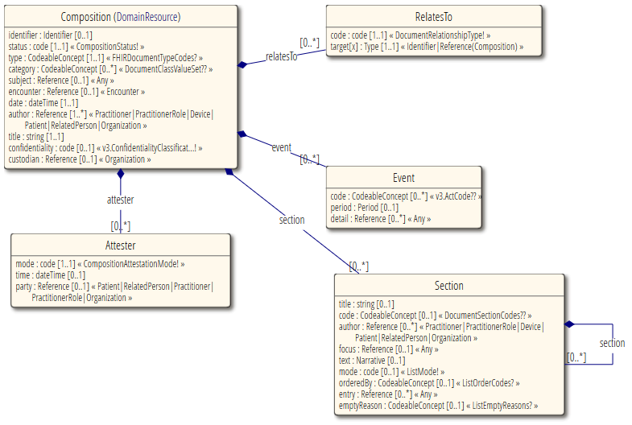
Documents Paradigm – Composition Resource (Header)

Slide 74
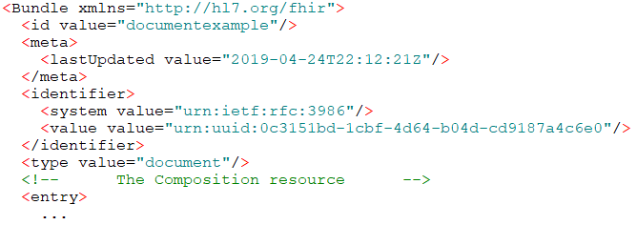
Documents Paradigm – Bundle.type = “document”
This Bundle is a Document

Slide 75
Documents Paradigm – Communicating http://hl7.org/fhir/documents.html#bundle
There are several other RESTful end-points that work with documents:
End-Point | Type of Content | Description
[baseurl]/Bundle | Document Bundle | This works like a normal end-point for managing a type of resource, but it works with whole document bundles - i.e. a read operation returns a bundle, an update gets a bundle and a search returns a bundle of bundles.
[baseurl]/Composition | Composition Resource | The normal end-point for managing composition resources. (This is where searching is supported.) This can be used while building a document or after breaking a document up into its constituent resources or when using compositions separately from documents.
[baseurl]/Binary | Document Bundle | Just store the entire document as a sequence of bytes and return exactly that sequence when requested.
[baseurl] (e.g. a transaction) | Document Bundle | Ignore the fact that the bundle is a document and process all of the resources that it contains as individual resources.

Slide 76

Documents Paradigm – CDA and FHIR
CDA to FHIR Document bridge
FHIR Document Processor
FHIR
Documents
FHIR
Repository
V3 CDA Documents
FHIR
REST
Hospital System
Note: Documents are compositions, no update semantics

Slide 77
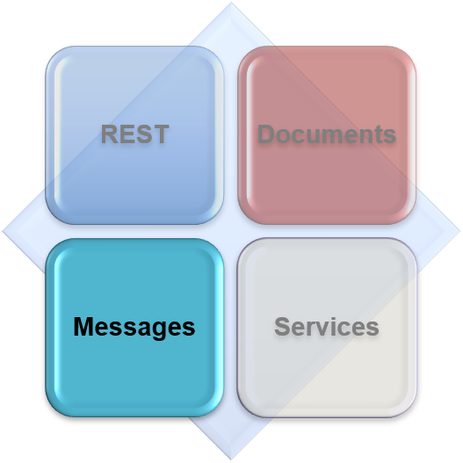
Interoperability paradigms
Messages

Slide 78
Messages Paradigm http://hl7.org/fhir/messaging.html
Similar to v2 and v3 messaging
Also, a collection of resources bound together
Root is a “MessageHeader” Resource Type
REST is not necessary, but…
$process-message operation defined to support this behavior
Event-driven
Example – Send a lab order
Server sends back result as another message (Bundle)
Can be asynchronous

Slide 79
Messages Paradigm – Bundle Provides Structure
MessageHeader Resource
<Bundle>
<entry>
<MessageHeader />
</entry>
<entry>
<Observation />
</entry>
<entry>
<Patient />
</entry>
<entry>
<Device/>
</entry>
</Bundle>
source
destination
event
Observation Resource
Device Resource
Patient Resource

Slide 80
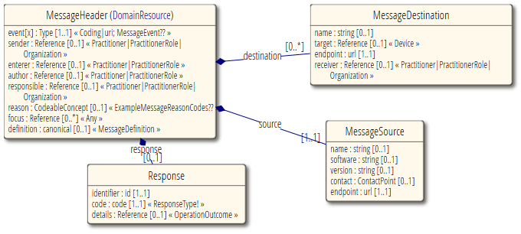
Messages Paradigm – MessageHeader Resource (Header)

Slide 81
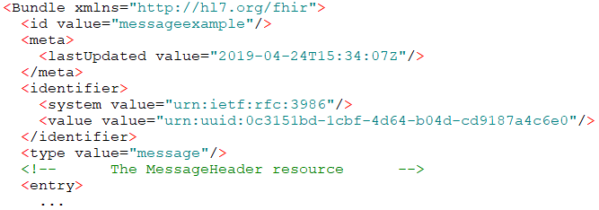
Messages Paradigm – Bundle.type = “message”
This Bundle is a Message

Slide 82
Messages Paradigm – V2 and FHIR
V2 to FHIR Message bridge
FHIR Message Processor
FHIR
Messages
FHIR
Repository
V2 Messages
FHIR
REST
Hospital System
Note: Messages are events, REST exposes a “Repository” Data Model

Slide 83

Interoperability paradigms
Services

Slide 84
Services Paradigm http://hl7.org/fhir/services.html
Combination of previous paradigms
Based on Service Oriented Architecture (SOA) principles
Supports complex workflows
Supports simple workflows
Although there many different design styles realizing FHIR and SOA together, the principal approaches are:
“Full Support in FHIR” – Utilizes FHIR RESTful APIs for all services/servers
“Classic SOA with FHIR Payload” – Relies heavily on traditional SOA service definition leveraging FHIR Resources as the parameters/payloads
Only constraint is that you pass around FHIR Resources in some way, shape, manner or form

Slide 85
Services Paradigm – Regardless, the Content is the Same
Receive lab results via messages…
FHIR
Repository
FHIR Message
FHIR Document
Lab System
REST
National
Exchange
…Package it in a discharge summary document

Slide 86
Services Paradigm – Considerations http://hl7.org/fhir/services.html#summary
SOA patterns applied correctly to FHIR implementations result in … enhanced consistency across implementations as well as enhanced interoperability and robustness.
Capability | FHIR + REST | FHIR + WS* | FHIR + SOA | Comments
Supports dynamic adjustment in workflows | ✗ | ○ | ✓ | In a native FHIR environment, this must be done by hand. The WS* stack provides for some interaction patterns, but limited. Use of formal notation (BPMN) and service orchestration is most robust option.
Supports ability to batch multiple operations | ○ | ○ | ✓ | FHIR Batch allows for concatenation of multiple process steps. SOA Orchestration allows for fine grained control, grouping and sequencing of multiple operations.
Provides for management of data coherence (e.g. Deadlocks, transactions) | ✗ | ✗ | ✓ | SOA principles define data governance, assigning responsibility for all data management within a service contract.
Provide support for orchestration languages (BPMN , SOAml ) | ✗ | ○ | ✓ | SOA applies a systematic framework for orchestration using industry accepted formalisms, avoiding costs and complexities associated with an ad-hoc approach

Slide 87
Services Paradigm – FHIR Operations Framework http://hl7.org/fhir/operations.html
When more complex logic is required beyond the simple CRUD interactions
Functionality that can be met more efficiently using an RPC-like paradigm
Some pre-defined operations already defined in the spec; example,
$everything – Get all data for a given Patient
$expand – ValueSet expansion/filter on terminology
See http://hl7.org/fhir/operationslist.html
Additional custom operations may be defined and published
OperationDefinition – typically within an Implementation Guide
Always uses FHIR Resources as the parameters/payloads
Parameters Resource Type used to define inputs and outputs

Slide 88
Services Paradigm – When to Use Custom Operations http://hl7.org/fhir/operations.html
The server plays an active role in formulating the content of the response, not just return existing information
The purpose is to cause side effects:
Modify existing resource, and/or
Create new resources, and/or
Other changes out of scope of the RESTful interface
The task involves business rules to be enforced across multiple/difference resources
The task involves several resources in a coordinated manner
Note: a transaction could be used, but an operation can more focused

Slide 89

Services Paradigm – Custom Operations List http://hl7.org/fhir/operationslist.html

Slide 90

Services Paradigm – Custom Operation Demo Immunization Forecasting
http://wildfhir4.aegis.net/fhir4-0-0

Slide 91

Searching – A Fundamental Part of FHIR

Slide 92
Searching – Starting with GET http://hl7.org/fhir/http.html#search
resource type
GET https://server.org/fhir/Patient?name=Smith
Note: No explicit ‘id’ in URL; instead, search criteria as URL parameters.
endpoint
search criteria

Slide 93

Searching – Resource Search Parameters
Each resource has a set of “standard” search parameters
Found at the bottom of every resource definition page
So, not all elements are searchable!
Patient example → http://hl7.org/fhir/patient.html#search
All Resources have common parameters

Slide 94
Searching – OK, I get it … or not?
http://server.org/fhir/Patient/ 406 hits
http://server.org/fhir/Patient?gender=M 234 hits
http://server.org/fhir/Patient?gender=F 167 hits
Total: 234 + 167 = 401
?
http://server.org/fhir/Patient/ 406 hits
http://server.org/fhir/Patient?gender=M 234 hits
http://server.org/fhir/Patient?gender=F 167 hits
http://server.org/fhir/Patient?gender:missing=true 5 hits
Total: 234 + 167 + 5 = 406

Slide 95

Searching – Bundle.type = “searchset”
This Bundle is a Searchset Result

Slide 96
Searching – Chained Searches http://hl7.org/fhir/search.html#chaining
Scenario – How to search for and return all Observations for a given Patient using the Patient’s name?
Patient has a search parameter for “name”
Observation has a search parameter for “patient” (reference to the subject when it is a Patient resource)
One solution (the hard way)
Search for the Patient(s) by “name”
Take Patient(s) from search results and execute <N> Observation searches for each found Patient
Or…

Slide 97
Searching – Chained Searches (2 queries in 1) http://hl7.org/fhir/search.html#chaining
Execute one search operation on the Observation resource
Using the Observation “patient” search parameter
Chain the Patient “name” parameter
https://server.com/fhir/Observation?patient.name=Jones
Note: This only works on the predefined search parameters of type “reference”. You cannot just use any element of the resource.

Slide 98
Searching – Including Other Resources http://hl7.org/fhir/search.html#include
Scenario – We search for and return all Observations for a given date. How do we include all the corresponding Patients?
Observation has a search parameter for “patient” (reference to the subject when it is a Patient resource)
One solution (the hard way)
Search for the Observations by “date”
Take Observation search results and execute <N> Patient searches for each Observation.subject where subject is a Patient
Or…

Slide 99
Searching – Including Other Resources (optimal way) http://hl7.org/fhir/search.html#include
Execute one search operation on the Observation resource
Use the Observation “patient” search parameter
Include all referenced Patient resources
https://server.com/fhir/Observation?date=2019-04-25
&_include=Observation:patient
Note: (Again) This only works on the predefined search parameters of type “reference”. You cannot just use any element of the resource.

Slide 100

Searching – Common (and not so common) Parameters http://hl7.org/fhir/search.html

Slide 101
Searching – Common Parameters http://hl7.org/fhir/search.html#standard
_id
Query by Id (string)
_lastUpdated
When the resource was last updated (date)
_tag
From the appropriate meta element (token)
_profile
From the appropriate meta element (url)
_security
From the appropriate meta element (token)
_text
Search in text element (string)

Slide 102
Searching – Common Parameters http://hl7.org/fhir/search.html#standard
_content
Search for text across the entire resource (string)
_list
Return resourced referenced by a List resource
Can use “current lists” and other queries – http://hl7.org/fhir/lifecycle#current
_has
Provides limited support for reverse chaining
_type
Allows search against one or more resource types
_query
Custom named query
Uses OperationDefinition for definition

Slide 103
Searching – Search Result Parameters http://hl7.org/fhir/search.html#return
_sort
Define the order of returned results by search parameter
_count
Specify the number of resources to include in the paged feed response
_include
Include other referenced resources
_revinclude
Include resources that reference this one; e.g. Provenance
_summary
Returned subset of each resource
Controlled by type: true, false, text, data, count
Resources are tagged as ‘SUBSETTED’

Slide 104
Searching – Search Result Parameters http://hl7.org/fhir/search.html#return
_total (trial use)
Indicates client preference for Bundle.total
Controlled by: none, estimate, accurate
_elements
Specify which elements to return (+mandatory)
Resources are tagged as ‘SUBSETTED’
_contained
Whether search should include contained resources
Controlled by: false (default), true, both
_containedType
Used with _contained – whether or not to return the container

Slide 105
Searching – Compartments http://hl7.org/fhir/http.html#vsearch
GET [base]/[Compartment]/[id]/[type]{?[parameters]{&_format=[mime-type]}}
Syntactic sugar for queries
Used with resources that share a common property
Example: Retrieve all Conditions with a particular code for a known Patient id
GET [base]/Patient/1234/Condition?code=2951-2
Purpose:
Provides an access mechanism for finding a set of related resources
Provides a definitional basis for quickly applying access control to related resources
Basis for $everything operation
Only defined by HL7
Five (5) Compartments: Patient, Encounter, RelatedPerson, Practitioner, Device

Slide 106
Searching – Special Case using HTTP POST http://hl7.org/fhir/http.html#search
POST [base]/[type]/_search{?[parameters]{&_format=[mime-type]}}
Content-Type: application/x-www-form-urlencoded
param1=value&param2=value
Same semantics as the equivalent GET method
Supports same search parameters in the URL path
Also supports search parameters in an application/x-www-form-urlencoded formatted request body
Note: application/x-www-form-urlencoded is supported for POST so that invoking a search by POST can be done from HTML forms in a browser...

Slide 107

Profiling And Validation

Slide 108
Profiling – Background (review) http://hl7.org/fhir/profiling.html
There are many different contexts in healthcare, but a single set of Resources
Need ability to restrict content based on usage and context
Need ability to extend content based on usage and context
These usage statements must allow:
Authoring/definition in a structured manner
Publishing to a know repository
Use as the basis for validation, code, report and UI generation
Profiling is important and necessary!

Slide 109
Profiling – Background (more…) http://hl7.org/fhir/profiling.html
The base resource types are not intended to be simply used as-is
Many different contexts in healthcare require specific implementations that:
Extend the base resources
Constrain the base resources
Bind to different code sets / terminologies
FHIR defines “Conformance” resource types to support profiling
See Conformance Module - http://hl7.org/fhir/conformance-module.html
Remember, FHIR is a platform specification; profiling:
Allows adaptation to specific purposes
Does not change the wire format of the data
The whole specification itself is built on the profiling infrastructure!

Slide 110
Profiling – Claiming Conformance
Profiles are similar to templates
Servers declare what profiles they support
Clients can (SHOULD) interrogate servers CapabilityStatement to discover supported profiles
Resource instances can “claim conformance” to one or more profiles
Resource instance metadata
Validation tools / libraries are available to test this
Instances can be conformant without claiming
Profiling restrictions
Can define additional constraints to elements
Can increase the constraint restrictions for elements
Cannot reduce or remove existing constraints

Slide 111

Profiling – Example using Patient (review)
Original (base) definition
List of constraints for our (example) profile:
Require that the identifier uses the NHI – and is required
Limit names to just 1 (instead of 0..*)
Limit maritalStatus to another set of codes that extends the one from HL7 International
Add an extension to support “iwi” (NZ example)
Note: hardly any mandatory elements in the core spec!

Slide 112
Profiling – Extensions http://hl7.org/fhir/extensibility.html
FHIR defines the most common element in the base resources (80% rule)
Keeps the resources relatively small
(Adding everything was a problem with V3)
Extensions allow other elements to be defined
Same capabilities as the core elements; e.g. references, bindings, etc.
Can extend properties and data types as well as the resource
Extensions are normal and expected
All implementations are expected to use extensions
Two (2) types of extensions
Normal – Can be safely ignored by the client if not understood
Modifier – Cannot be ignored regardless of known or unknown

Slide 113

Profiling – US Core Patient Example – Simple Extension
url = location of formal definition
value = value according to the definition

Slide 114

Profiling – US Core Patient Example – Complex Extension

Slide 115

Profiling – US Core R4 Implementation Guide https://build.fhir.org/ig/HL7/US-Core-R4/index.html

Slide 116

Profiling – US Core R4 – Patient Profile https://build.fhir.org/ig/HL7/US-Core-R4/StructureDefinition-us-core-patient.html

Slide 117

Profiling – Forge Tool (fire.ly) https://fire.ly/forge

Slide 118

Profiling – Slicing (on repeating elements) http://hl7.org/fhir/profiling.html#slicing
Technique used to constrain individual elements occurring in a list of repeating elements
Example shown is for a Blood Pressure Observation
Observation.component repeats
Two (2) instances of component are constrained:
One for the Systolic reading
One for the Diastolic reading

Slide 119

Profiling – Claiming Conformance – Resource Instance

Slide 120
Profiling – Validating the Claim http://hl7.org/fhir/validation.html
FHIR Validator / Validation Engine
Validating the conformance claim means checking…
Structure – check the content is all there, nothing extra
Cardinality – check min & max occurrences for all elements
Value Domains – all values conform to their specified types
Code Bindings – check all code values are from the specified terminology
Invariants – check all constraint rules have been followed
Profiles – apply all stated profiles against the content
Questionnaires – check that a QuestionnaireResponse is valid
Business Rules – these are outside the specification and require special handling

Slide 121
Profiling – Validation Tools http://hl7.org/fhir/validation.html
Schema Check
XML Schema + Schematron
JSON Schema
RDF Schema (ShEx)
Use the FHIR Validator
http://wiki.hl7.org/index.php?title=Using_the_FHIR_Validator
Available as a Java jar and provided as part of the specification
Ask a FHIR Server
$validate operation is defined for FHIR servers to support validation as a service
Not all FHIR servers will support this operation
Server may choose to support XML, JSON or both

Slide 122

Profiling – Distributed Validation
Profile X
App server
Profile Y
Country or regional
validation server
Store & Validate
Validate X
Profile Y
Profile X
Download & Validate
Profile Y

Slide 123

Implementing FHIR

Slide 124
Implementing FHIR – Downloads http://hl7.org/fhir/downloads.html
FHIR Specification Downloads
FHIR Definitions – All the value sets, profiles, etc. defined as part of the FHIR specification, and the included implementation guides
Examples – All the example resources in XML, JSON and RDF formats
The Whole Spec! – So that you can host your own local copy
Implementation Tools
Official FHIR Validator – Java jar file that can be used the validate resources
IG Publisher – The Implementation Guide Publishing Tool
Reference Implementations
Java – HAPI-FHIR (http://jamesagnew.github.io/hapi-fhir)
C# – HL7.FHIR (http://www.nuget.org/packages/Hl7.Fhir)
Pascal – FhirServer (http://github.com/grahamegrieve/fhirserver)
JavaScript – See HL7 wiki (http://wiki.hl7.org/index.php?title=Open_Source_FHIR_implementations)

Slide 125
Implementing FHIR – Java Reference Implementation (HAPI-FHIR) http://hapifhir.io & https://github.com/jamesagnew/hapi-fhir
HL7 Application Programming Interface for FHIR
Provides:
Open source projects and libraries
Feature rich implementation of a FHIR Client and Server
Deploys to many open and licensed Servlet Container: Tomcat, JBoss, Websphere, etc.
Leverages JPA Server for connection to many backend DBMS’
Builds upon the base Java RI source code from the specification
Great place to start without having to build from scratch

Slide 126
Implementing FHIR – C#/.NET Reference Implementation (Firely) https://github.com/FirelyTeam/fhir-net-api
The official support API for HL7 FHIR on the Microsoft .NET (dotnet) platform
Provides:
Class models (POCOs) for the FHIR data model
XML and Json parsers and serializers
FHIR compliant REST Client
Validation engine supporting FHIR Implementation Guides and Profiles
FHIRPath expression engine
Full release notes available on the Firely Simplifier site:
http://docs.simplifier.net/fhirnetapi/releasenotes.html

Slide 127
Implementing FHIR – Java Code Example (parsing/serializing)
XmlParser xml = new XmlParser();
Observation obs = (Observation)xml.parse(new FileInputStream("observation.xml"));
obs.setStatusSimple(ObservationStatus.amended);
Quantity newValue = new Quantity();
newValue.setValueSimple(new BigDecimal(40));
newValue.setUnitsSimple("g");
obs.setValue( newValue );
ByteArrayOutputStream bos = new ByteArrayOutputStream();
JsonComposer comp = new JsonComposer();
comp.compose(bos, obs, true);
String json = bos.toString("UTF8");

Slide 128
Implementing FHIR – C# Code Example (parsing/serializing)
// Create a file-based reader for Xml
XmlReader xr = XmlReader.Create(new StreamReader(@"publish\observation-example.xml"));
// Parse the Observation from the stream
var obs = (Observation)FhirParser.ParseResource(xr);
// Modify some fields of the observation
obs.Status = Observation.ObservationStatus.Amended;
obs.Value = new Quantity() { Value = 40, Units = "g" };
// Serialize the in-memory observation to Json
var jsonText = FhirSerializer.SerializeResourceToJson(obs);

Slide 129
Implementing FHIR – Java Code Example (FHIR Client)
FhirContext ctx = FhirContext.forDstu3();
String serverBase = "http://fhirtest.uhn.ca/baseDstu3";
IGenericClient client = ctx.newRestfulGenericClient(serverBase);
// Perform a search
Bundle results = client.search()
.forResource(Patient.class)
.where(Patient.FAMILY.matches().value("duck"))
.returnBundle(ca.uhn.fhir.model.dstu3.resource.Bundle.class)
.execute();
System.out.println("Found " + results.getEntry().size() + " patients named 'duck’”);

Slide 130
Implementing FHIR – C# Code Example (FHIR Client)
var client = new FhirClient(new Uri("http://fhir.com/svc/fhir"));
var patEntry = client.Read<Patient>("1");
var pat = patEntry.Resource;
var restId = patEntry.Id;
var tags = patEntry.Tags;
pat.Name.Add(HumanName.ForFamily("Kramer").WithGiven("Ewout"));
client.Update<Patient>(patEntry);

Slide 131
Implementing FHIR – Building the Spec (not for everyone) http://wiki.hl7.org/index.php?title=FHIR_Build_Process
The FHIR build process is primarily used by a small group of committers to the specification
Requires a particular Java environment along with a couple of supporting tools
Java SDK 8 (1.8.0.x) – Java 9, 10 and 11 will work; Java 12 will not right now
Apache Ant
Ruby + Jekyll Gem
(Optional) .NET 4.x if you are compiling the .NET reference implementation
Check out the FHIR specification:
FHIR STU3 (v3.0.1) and prior – HL7 gForge Subversion (https://gforge.hl7.org/svn/fhir)
FHIR R4 (v4.0.0) going forward – HL7/fhir Github repo (https://github.com/HL7/fhir)
Customize and execute “publish.bat” or “publish.sh”
Will need to update reference to local Java SDK install

Slide 132

Implementing FHIR – Java Reference Implementation Source Code
Regardless of whether you build the FHIR specification or not, when you check out the specification you have a full copy of all the Java RI source code

Slide 133


Implementing FHIR – Build your own Java HL7 FHIR Core Library
+

Slide 134

Final Thoughts

Slide 135
Final Thoughts – FHIR in other Specifications
FHIRPath
http://hl7.org/fhirpath
FHIR Mapping Language
http://hl7.org/fhir/mapping-language.html
CDS Hooks
https://cds-hooks.org
SMART on FHIR
https://smarthealthit.org
IHE (on FHIR) Profiles
https://www.ihe.net

Slide 136

Final Thoughts – SMART on FHIR Example

Slide 137
Final Thoughts – Security http://hl7.org/fhir/security.html
FHIR is not a security standard
Leverages existing standards (OAuth2, SSL, TLS, …)
New and existing standards using FHIR that may impose security
CDS Hooks and SMART (OAuth2)
IHE on FHIR
Security tags (Resource metadata)
Specialized resources
AuditEvent, Consent, Provenance

Slide 138
Final Thoughts – Next Steps for you
(Keep) Read(ing) the spec: http://hl7.org.fhir
Implement / Develop
Get involved in the FHIR Community – help shape the specification
Join the FHIR track at the Working Group Meetings
Join the FHIR email lists
Follow #FHIR on Twitter and Zulip (http://chat.fhir.org)
Implement it
Make Ballot comments
Come to and participant in a Connectathon
FHIR Developers Days (https://www.fhirdevdays.com)
YouTube+FHIR – Lots of recorded tutorials

Slide 139

Wrap Up – HL7 FHIR R4 Proficiency Exam Package
Buy the HL7® FHIR® R4 Proficiency Exam, get the Exam Review class half off!
Exam review class runs September 26 & 27
Instructor: Virginia Lorenzi

Slide 140

Wrap Up – Get FHIR Certified, Get Free Starbucks!
Sign up here ONSITE AT THE WGM for either:
Any HL7 Certification Exam (including V2, V3, CDA & FHIR)
HL7 FHIR R4 Exam Review Package (includes online class)
Get a $20 Starbuck gift card!

Slide 141
Wrap Up – Evaluations
We value your feedback!
Please complete the online evaluation form.
This will make you eligible for a drawing to win a voucher worth $325 towards the purchase of any educational products on our Education on Demand site.

Slide 142

Wrap Up – Discussion (Q&A)

